Slide 1

Compact Hybrid System for Wind-Assisted Passive CO₂ Capture
Zephyr
Notes:
Innovation
2. Road map
3. Market graphs
Thank u slide

Slide 2
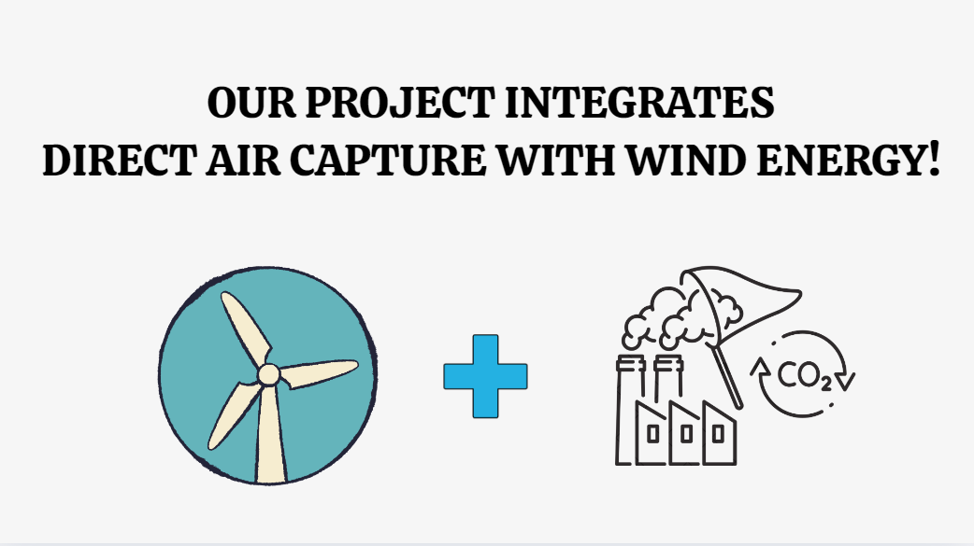
THE IDEA!
As global warming slowly turns to global boiling, there is a need to:
Reduce carbon dioxide emissions, by using sustainable renewable forms of energy.
Capture the CO₂ already present in the atmosphere.
We asked ourselves an important question:
What if there was a way to combine renewable energy with DAC?

Slide 3
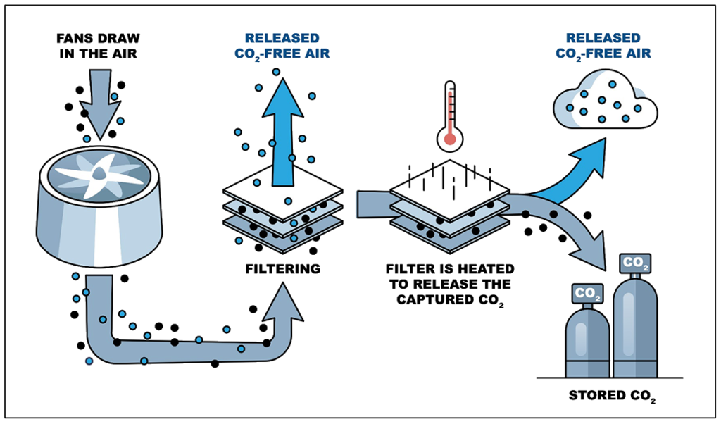
Major Drawback of Present DAC:
Capturing CO₂ is an expensive process. Moreover, the carbon dioxide in the atmosphere is typically more diluted and harder to extract, causing an increase in in DAC’s energy needs and costs.

Slide 4
LIMITATIONS OF EXISTING TECHNOLOGIES:
Challenges | Why it exists
High energy consumption | Even new technologies require high energy inputs to scale
High expense | Innovations assist, but expenses remain far from competitiveness
Low CO₂ concentration | Physical constraint; huge amounts of air have to be treated
Sorbent degradation | Materials wear out; replacements increase cost and complexity
Land/infrastructure | Compactness is traded off against efficiency; passive systems require space
Storage infrastructure | Storage alternatives are limited, costly, and difficult to scale quickly
Environmental/public issues | Perception and effect concerns persist; risk of misuse or "greenwashing"

Slide 5
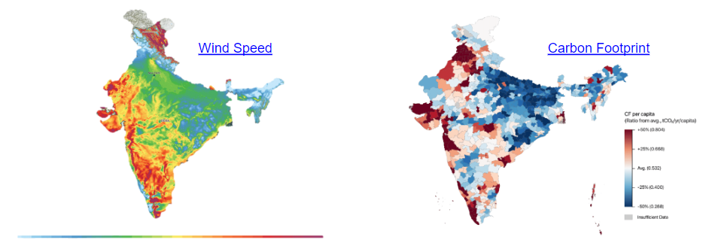
Renewable Wind Energy:
When the wind patterns and carbon footprint of India are analysed, it is interesting to observe that areas with higher carbon emissions are typically associated with moderate to high wind speeds.

Slide 6
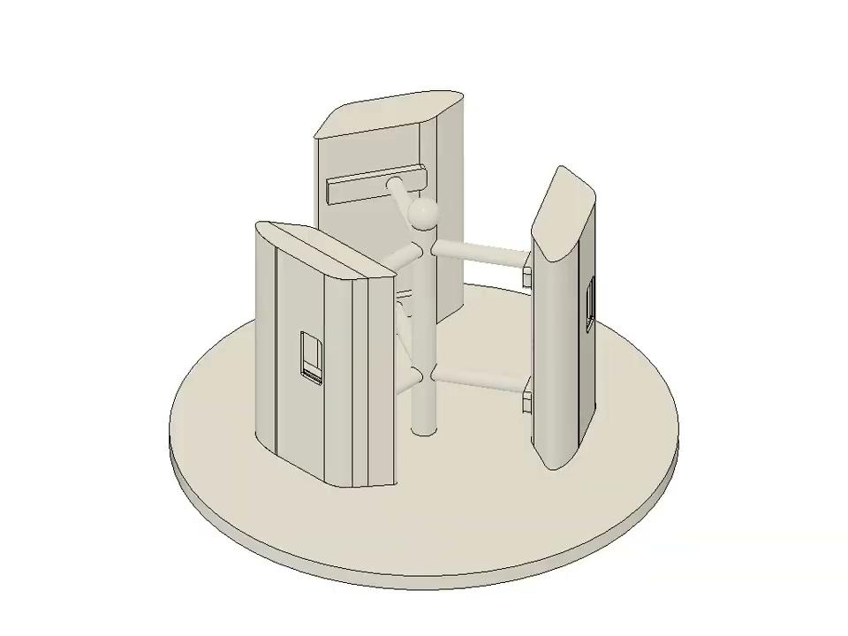
The next big question: How do we harness the power of the wind efficiently?
On researching the different kinds of wind turbines and weighing the pros and cons of each type, we decided to use H-TYPE Vertical Axis Wind Turbines.
Advantages of VAWTs:
Omnidirectional Wind Acceptance
Compact & Space-Efficient Design
Lower Maintenance
Better Performance in Low Wind Speeds & Turbulent Flows
Safe and Quiet Operation
Ease of Prototyping

Slide 7
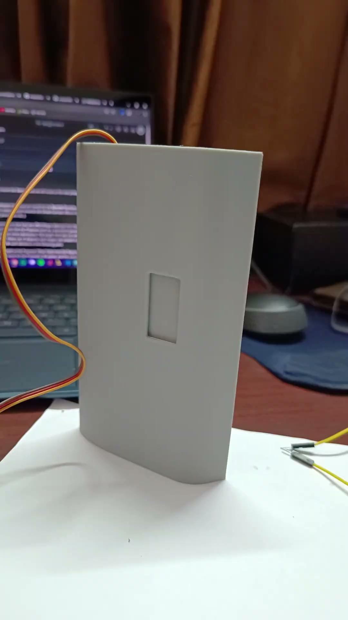
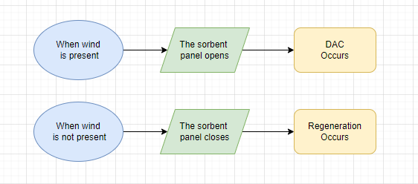
Our Challenge: Integrating the DAC with the vertical axis wind turbine
After testing multiple ideas finally, we decided to create an automated system where based on availability of wind,sorbent panels, that are integrated into the blade, either opens or closes.

Slide 8
To allow the movement of the panel, we have used a SG90 Continuous Servo Motor.

Slide 9
The next step was to find a way to efficiently regenerate the sorbent
We have used nichrome wire for electric heating of the sorbent.
At temperatures close to 100 degrees celsius, the zeolite releases back the CO₂ it had captured.
We have used a CO₂ sensor to calculate the amount of carbon dioxide that the zeolite had captured.

Slide 10
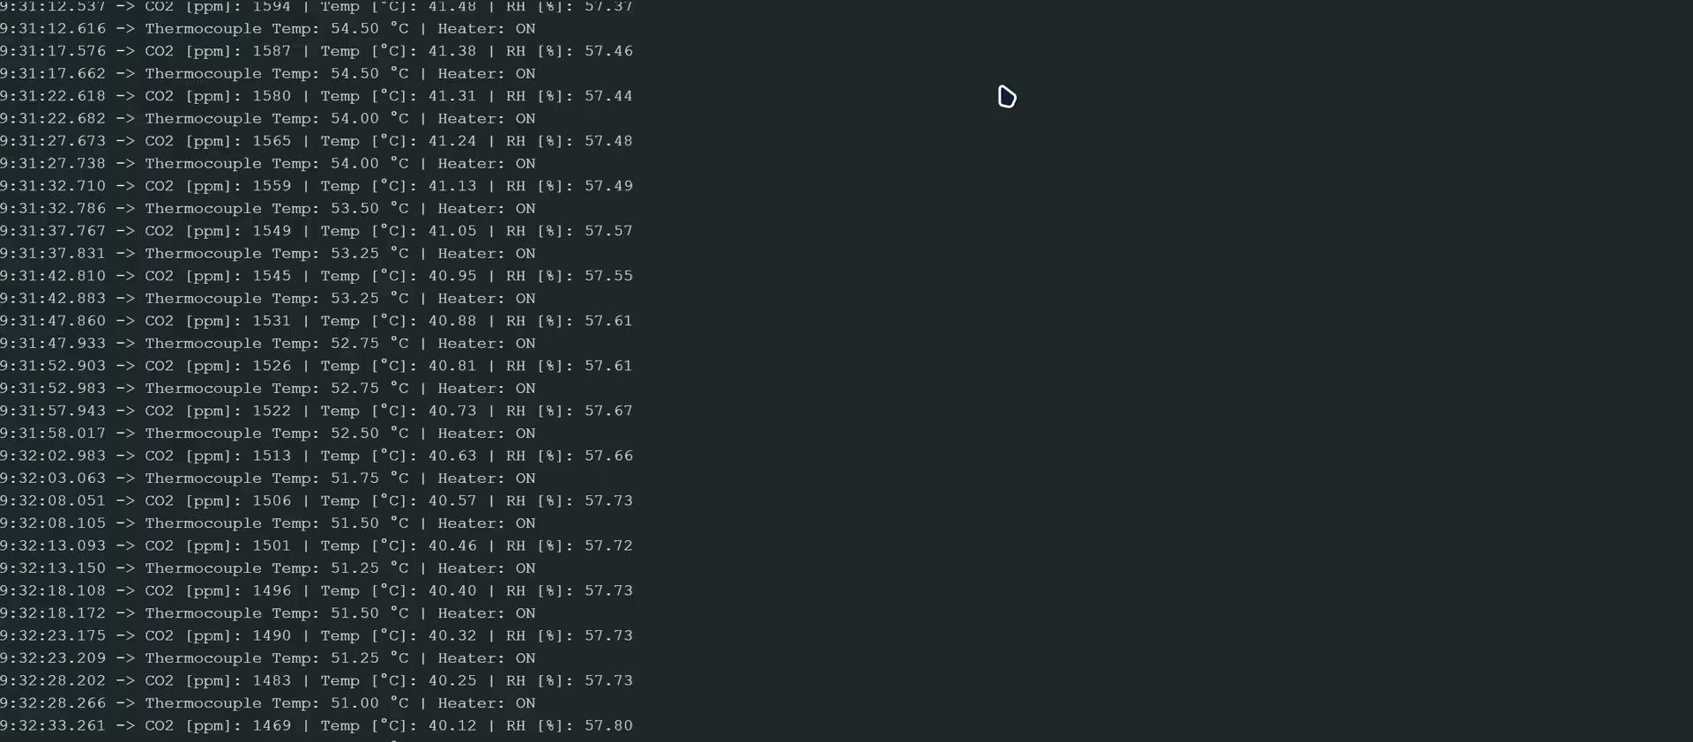
READINGS:

Slide 11
ROADMAP - MVP
Concept Development
3D Modelling
Prototyping & Testing
Iteration & Scaling
Design and Planning
Material & Component Selection
Combined wind energy with passive CO₂ direct air capture.
Created Fusion 360 models of blade and internals.
Assembled components and conducted basic functional trials.
1
3
5
2
4
6
Finalized blade, sorbent, actuator, and thermal regeneration setup.
Chose zeolite, nichrome, actuator, and structural materials.
Planned improvements and roadmap for scalable future version.

Slide 12
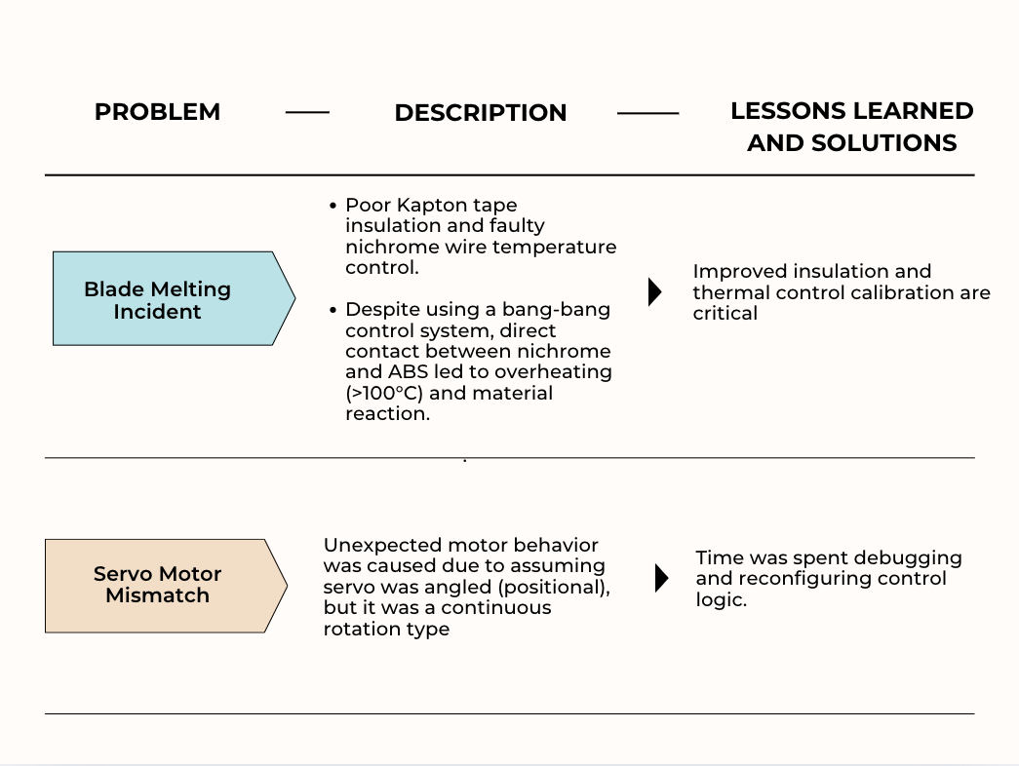
Setbacks and How We Overcame Them:

Slide 13
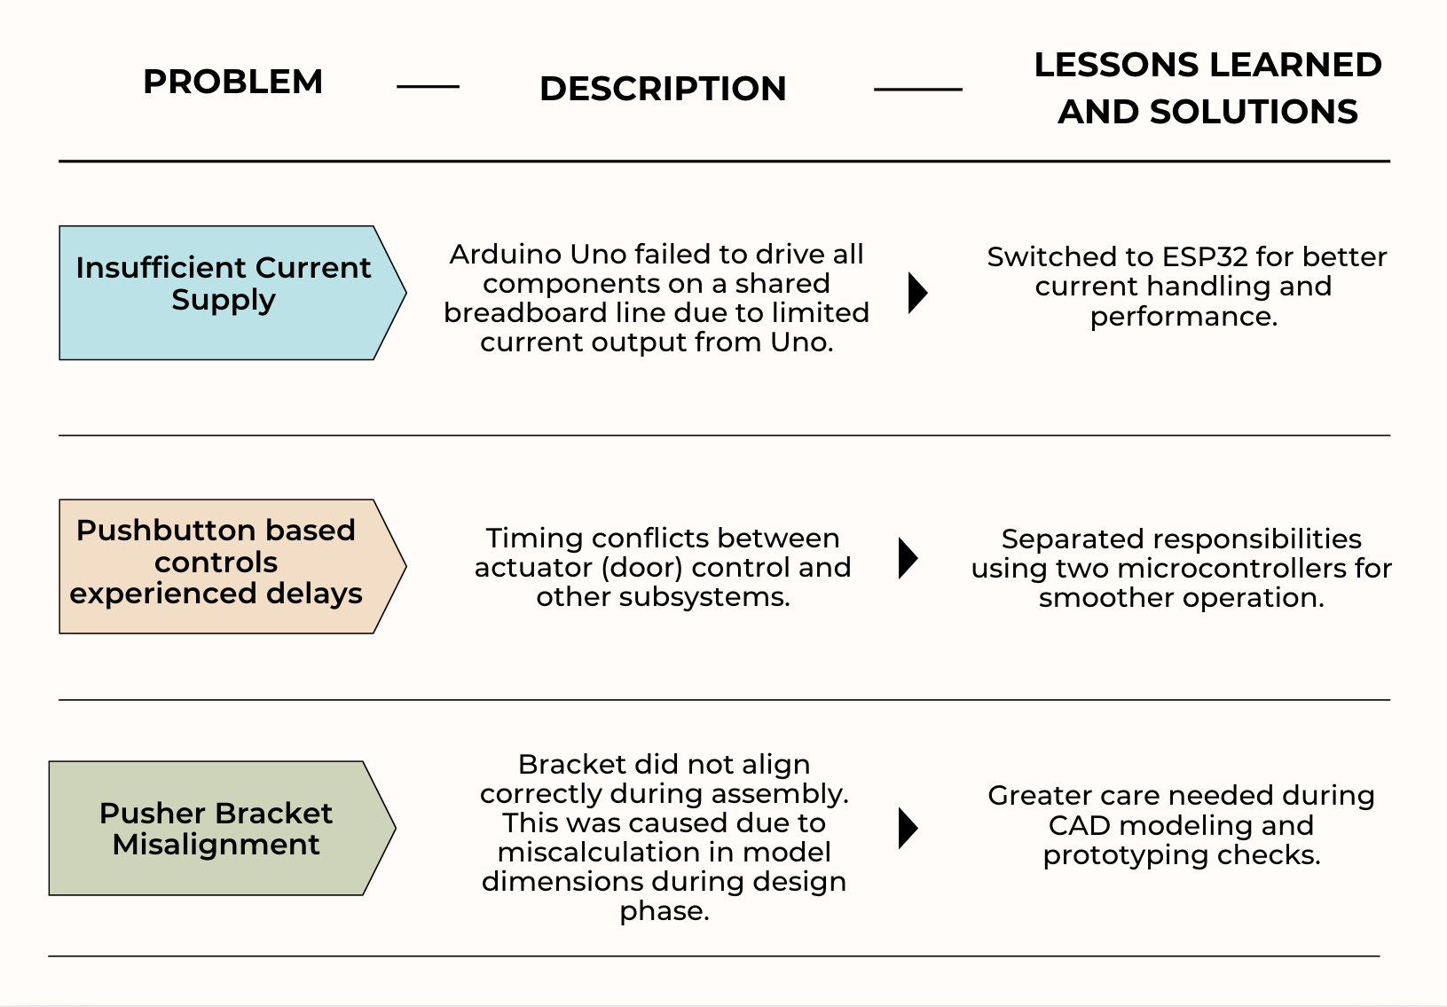

Slide 14
SWOT ANALYSIS
STRENGTHS
DAC occurs effectively
Renewable wind energy captured
Modular design
Easy deployment
WEAKNESSES
Requires large-scale deployment to capture significant CO₂ quantities
Prototype efficiency may be limited without precision engineering or advanced materials
S
W
Deploy in rural and urban locations
Situate the model close to industries for maximising CO₂ capture
OPPORTUNITIES
Low Wind Speeds or Inconsistent Wind Conditions
High Initial Prototyping or Material Costs
THREATS
O
T

Slide 15
SWOT ANALYSIS - Strengths
STRENGTHS
Passive DAC system
Energy is saved (no need for fans/contractors)
Self-automating system
Omnidirectional Wind Capture
Environmentally Friendly Operation
Integration-Friendly
Modular and Scalable Design
Compact and Easy Deployment
S
S

Slide 16
SWOT ANALYSIS
WEAKNESSES
Limited CO₂ Capture per Unit
High Cost of Sorbent Materials
Scaling Challenges
Dependence on Wind Availability
Need for Regular Sorbent Regeneration or Replacement
W

Slide 17
SWOT ANALYSIS
O
OPPORTUNITIES
Deployment in Diverse Locations
Proximity to High CO₂ Emitters
Growing Demand for Climate Tech
Government and NGO Support
Integration with Smart Grids or Hybrid Systems
Scalability for Community Projects
Industry Collaborations
Positive Public and Media Reception as it provides dual solutions

Slide 18
SWOT ANALYSIS
T
THREATS
Low or Inconsistent Wind Speeds
High Initial Prototyping and Material Costs
Degradation of Sorbent Materials
Mechanical Failures or Wear
Limited Real-World Testing Opportunities
Competing Technologies
Environmental Exposure Risks
Public or Stakeholder Skepticism

Slide 19
MARKET POTENTIAL
Target Users:
Industries, governments, eco-startups, green buildings.
Growing Demand
Carbon capture & clean energy are key to climate goals.
India’s Net Zero by 2070 & global carbon credit markets support this tech.
Global Push:
Modular structure allows adding multiple units to scale output. Can be adapted for rooftops, fields, industrial zones
High Scalability:
Notes:
Scalability Factors:
✅ Modular structure allows adding multiple units to scale output
✅ Can be adapted for rooftops, fields, industrial zones
⚠️ Cost and material sourcing must be optimized for large-scale rollout
✅ Smart upgrades (IoT, AI) possible in future versions
Conclusion: 🟢 Highly scalable concept with adjustments in design and cost optimization for mass deployment.

Slide 20
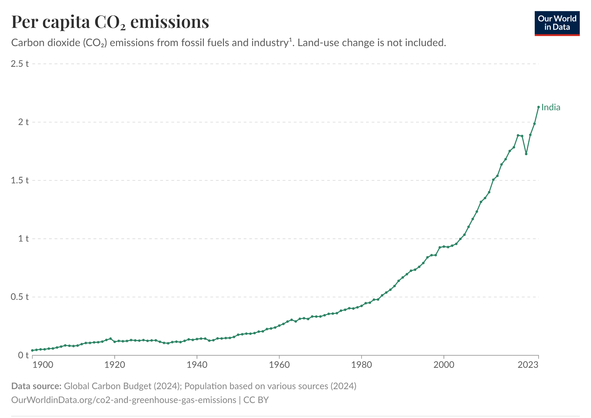
Annual total emissions of carbon dioxide (CO₂), excluding land-use change, measured in tonnes per person.
Source: Global Carbon Budget (2024), Population based on various sources (2024) – with major processing by Our World in Data

Slide 21
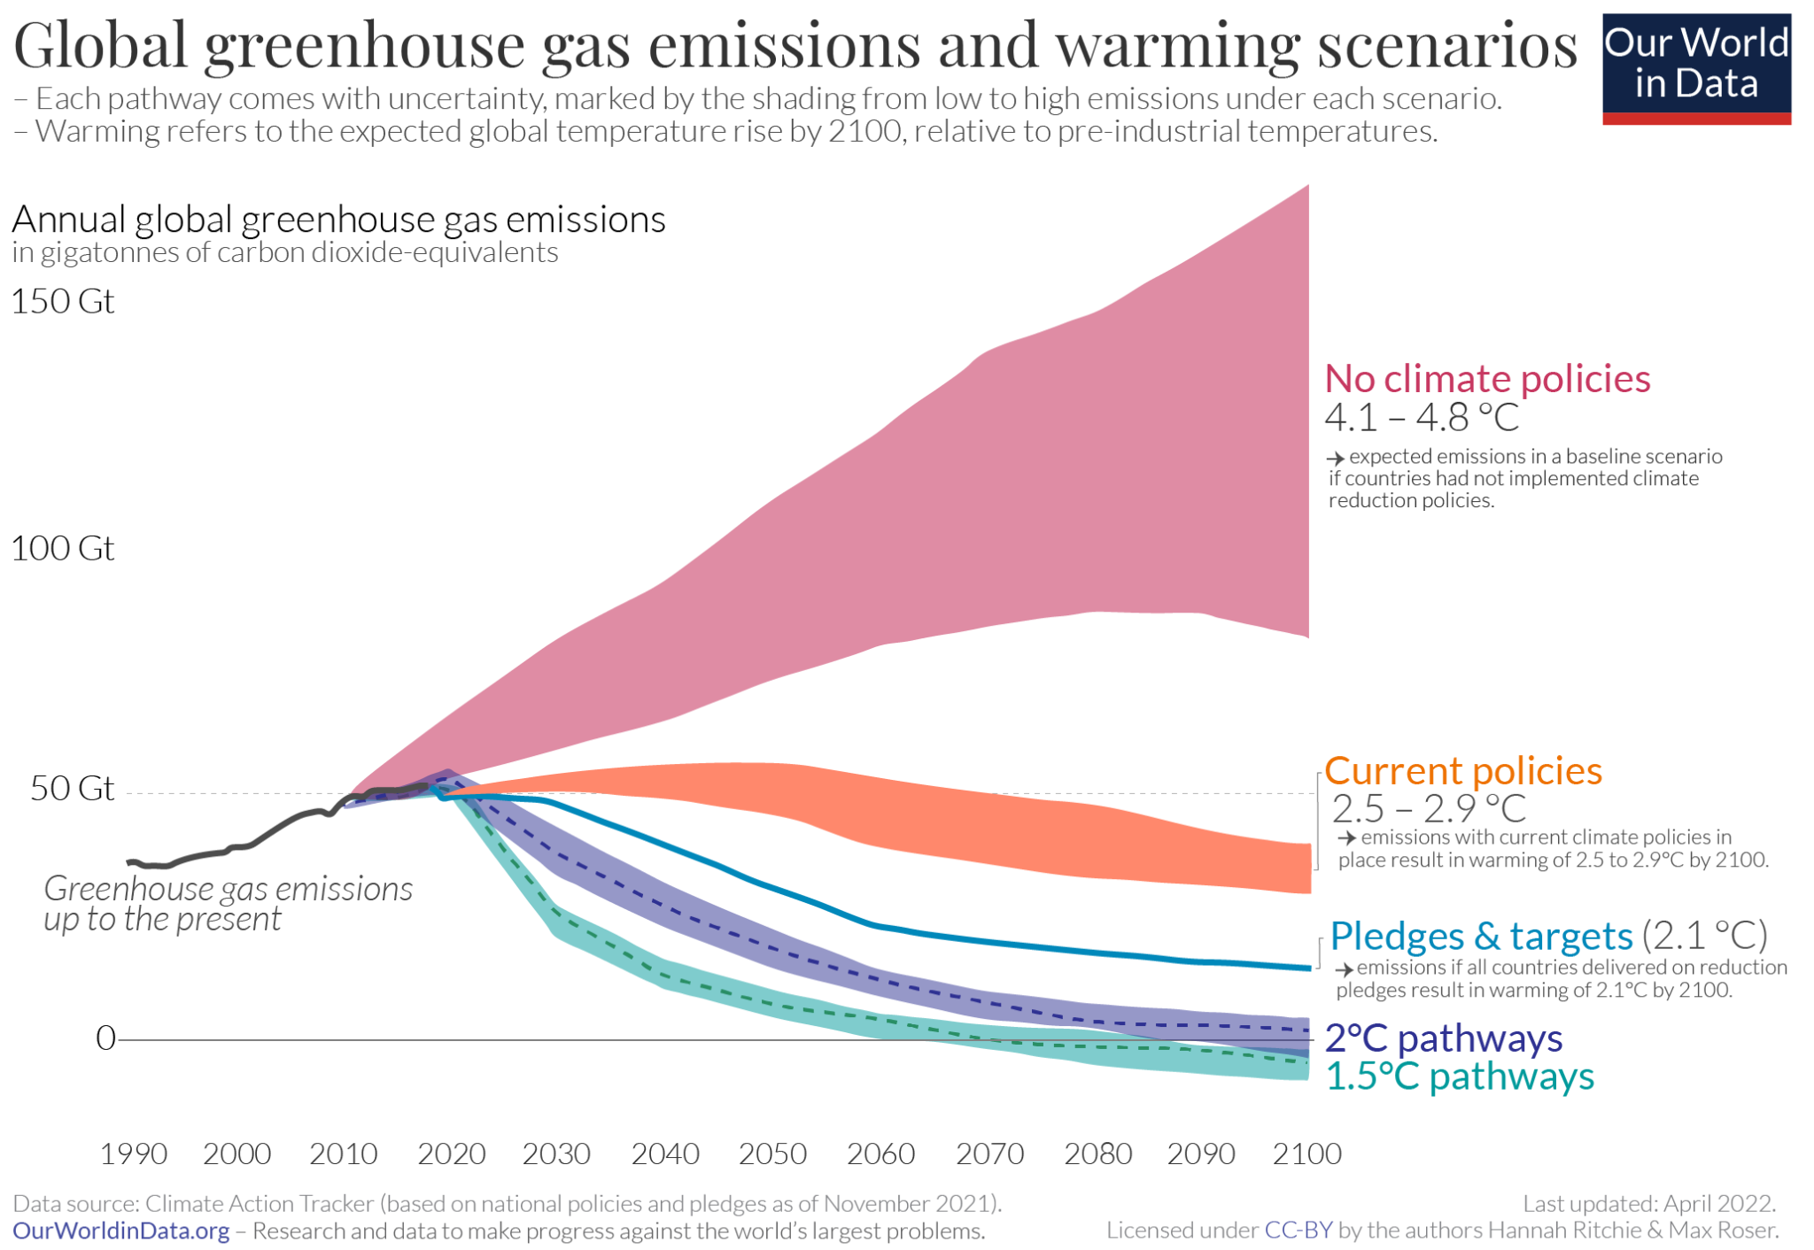
This chart maps out future greenhouse gas emissions scenarios under a range of assumptions: if no climate policies were implemented; if current policies continued; if all countries achieved their current future pledges for emissions reductions.

Slide 22
Feasibility
Technical:
VAWT and DAC technologies are both proven independently
Scalable with modular design
Operational:
Easy to deploy in a variety of locations
Low maintenance if designed with durable materials
Safe to operate

Slide 23
Feasibility
Economical:
Low Prototype Cost
Minimal Operational Cost
Scaling may require higher upfront costs
Government incentives could provide additional feasibility as project aligns with national and international climate goals
Environmental:
This is a Carbon-Negative System
Captures CO₂
Uses Wind Energy
Possible to use more sustainable materials for design
An innovative way to combat climate change

Slide 24
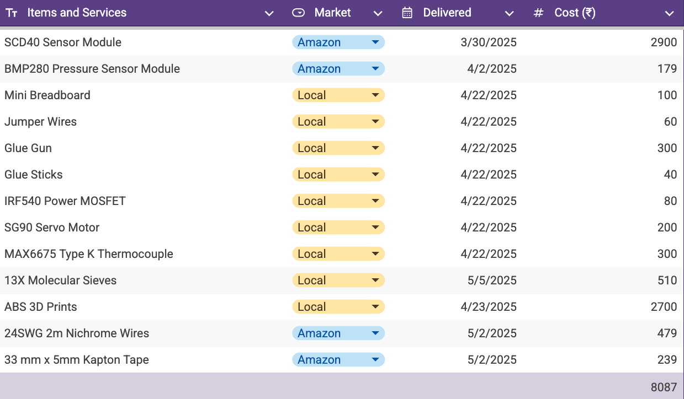
A TRACK OF OUR EXPENSES:

Slide 25
Thanks!
ANY QUESTIONS?

